Slide 1

Αντι-αιμοπεταλιακή αγωγή στην Περιφερική Αγγειοπάθεια
Δρ. Κωνσταντίνος Κατσάνος
Επεμβατικός Ακτινολόγος
MSc, MD, PhD, EBIR

Slide 2
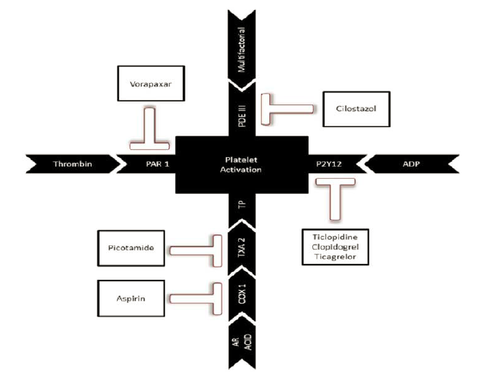

Slide 3
Antiplatelets in PAD
Current guidelines
Clopidogrel & Aspirin
Clopidogrel resistance
Ticagrelor data
NOAC & Aspirin

Slide 4
Antiplatelets in PAD
Current guidelines
Clopidogrel & Aspirin
Clopidogrel resistance
Ticagrelor data
NOAC & Aspirin

Slide 5
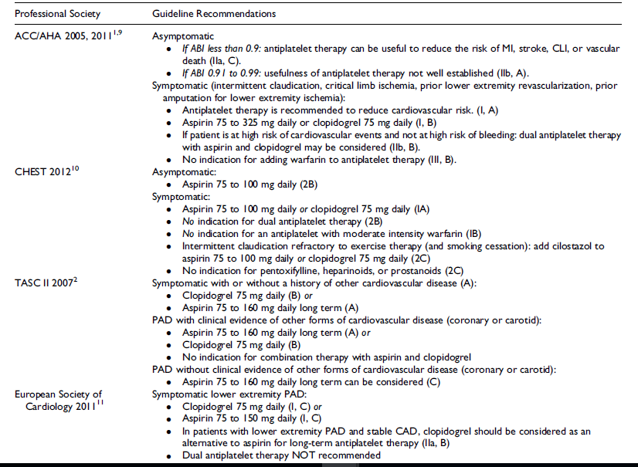

Slide 6
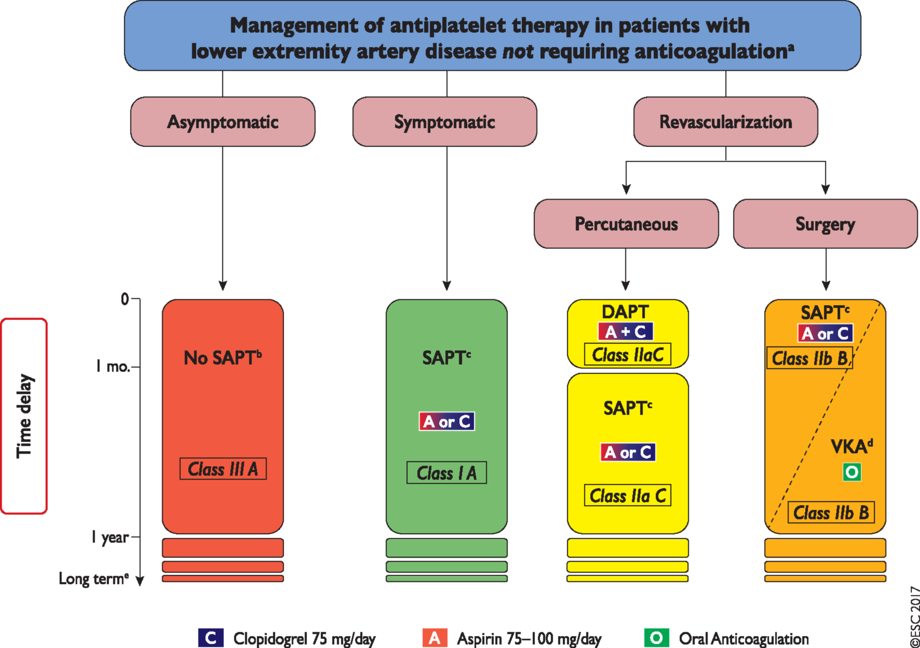
2017 ESC Guidelines on the Diagnosis and Treatment of Peripheral Arterial Diseases, in collaboration with the European Society for Vascular Surgery (ESVS)

Slide 7
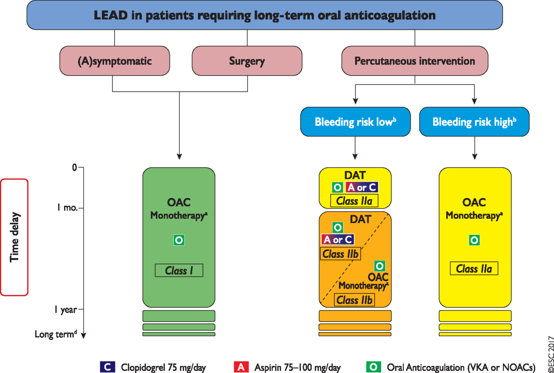
2017 ESC Guidelines on the Diagnosis and Treatment of Peripheral Arterial Diseases, in collaboration with the European Society for Vascular Surgery (ESVS)

Slide 8
Antiplatelets in PAD
Current guidelines
Clopidogrel & Aspirin
Clopidogrel resistance
Ticagrelor data
NOAC & Aspirin

Slide 9
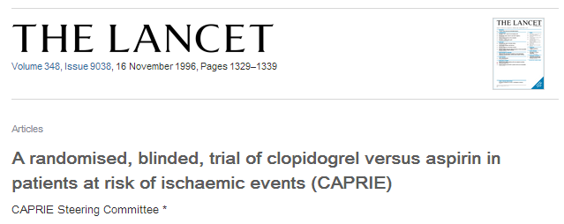
ADP-P2Y₁₂ inhibitor Clopidogrel versus COX-1 inhibitor Aspirin
Clopidogrel 24% relative risk reduction in major cardiovascular events compared to aspirin in symptomatic PAD patients
Absolute risk reduction 0.51% per year; p= 0.043
Similar bleeding (around 9%) - Similar severe (1.38% clopidogrel vs. 1.55% ASA) - Similar intracranial bleeding (0.35% clopidogrel vs. 0.49% ASA)

Slide 10
Clopidogrel
Clopidogrel is a thienopyridine used for more than a decade in patients with PAD
P2Y12 antagonist which inhibits ADP-induced platelet aggregation
Pro-drug active metabolite (R-130964) that binds irreversibly and selectively to the P2Y12 receptor
At regular daily doses: platelet inhibition over days
Quinn MJ, et al. Ticlopidine and clopidogrel. Circulation. 1999;100:1667-1672

Slide 11
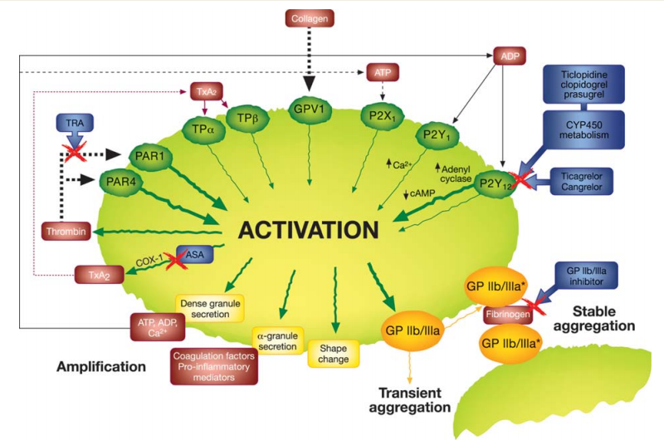
ADP inhibitors
Storey RF, Biology and pharmacology of P2Y12 receptors . Curr Pharm Des 2006

Slide 12
Antiplatelets in PAD patients
49 RCTs including 34,518 patients with 88,358 person-years of follow-up
Katsanos K, et al. Comparative Efficacy and Safety of Different Antiplatelets in PAD. PLoS One. 2015 Aug
.

Slide 13
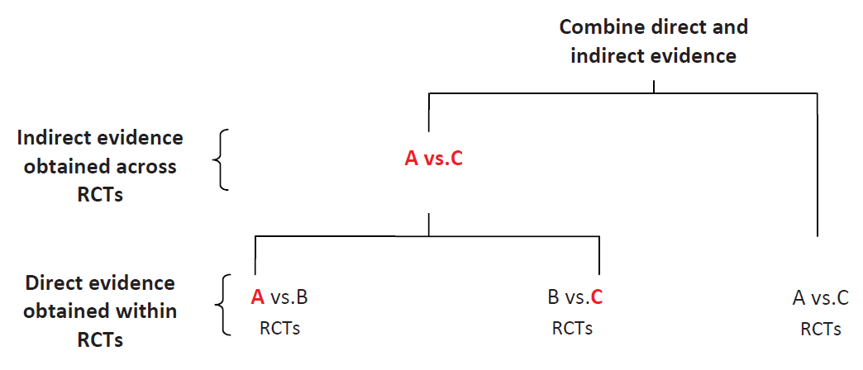
Network meta-analysis
Li et al.
BMC Medicine 2011, 9:79

Slide 14
Composite endpoint analysis
Composite endpoint of Vascular deaths, non-fatal MI, non-fatal stroke
22-32% relative risk reduction
Aspirin NOT effective!
Katsanos K, et al. Comparative Efficacy and Safety of Different Antiplatelets in PAD. PLoS One. 2015 Aug
.

Slide 15
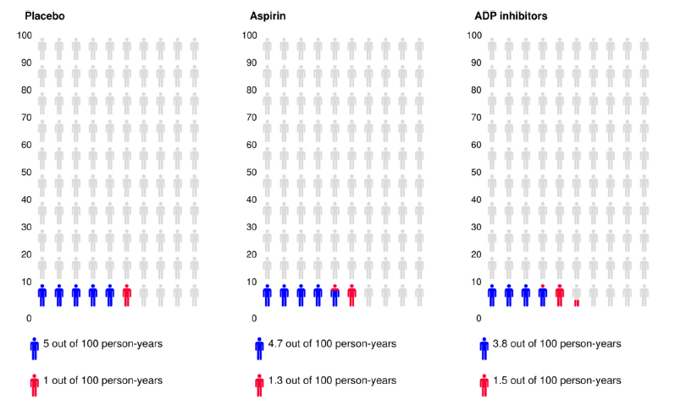
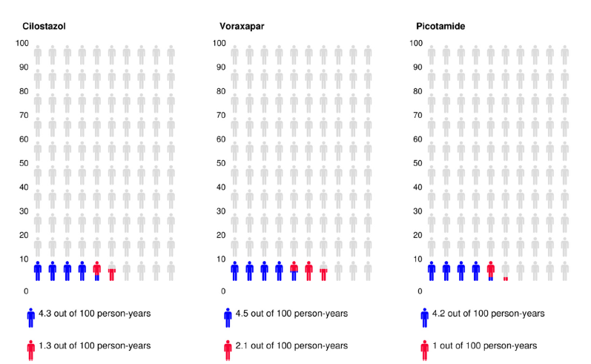
MACE event rates

Slide 16
Major amputations
Major lower limb amputations above ankle
37% relative risk reduction
Katsanos K, et al. Comparative Efficacy and Safety of Different Antiplatelets in PAD. PLoS One. 2015 Aug
.

Slide 17
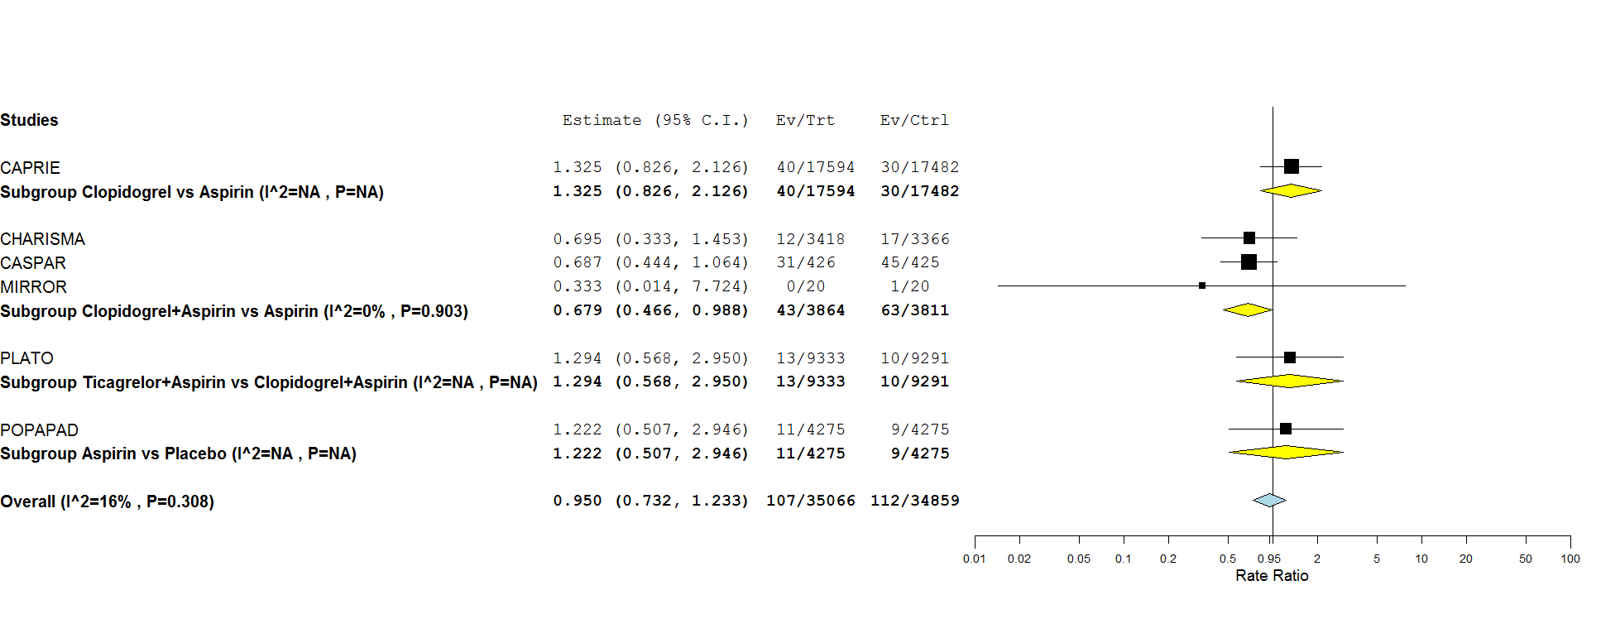
Major amputations
Direct frequentist analysis of >7,600 cases
CHARISMA, CASPAR & MIRROR studies
Mostly post revascularization
32% relative risk reduction – HR 0.68 compared to Aspirin
Katsanos K, et al. Comparative Efficacy and Safety of Different Antiplatelets in PAD. PLoS One. 2015 Aug
.

Slide 18
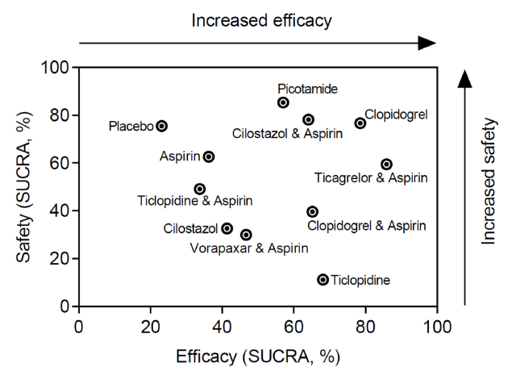
Probabilities best and safest
Katsanos K, et al. Comparative Efficacy and Safety of Different Antiplatelets in PAD. PLoS One. 2015 Aug
.

Slide 19
Antiplatelets in PAD
Current guidelines
Clopidogrel & Aspirin
Clopidogrel resistance
Ticagrelor data
NOAC & Aspirin

Slide 20
High on Treatment Platelet Reactivity (HTPR)
Patients with high platelet reactivity despite antiplatelet therapy are referred as non-responders and the phenomenon as high on-treatment platelet reactivity
Meta-analyses of >50 studies revealed that HTPR are significantly associated with MACE (relative risk of 2.09 and 2.8, respectively, for Aspirin and Clopidogrel).
Prevalence of HTPR for Aspirin in PAD varies 5-40% among different studies based on various assays
Prevalence of HTPR in PAD patients on clopidogrel therapy has been documented to be up to 50%

Slide 21
HTPR coronary summary
HTPR strong independent predictor of thrombotic events – especially stent thrombosis post PCI
Stronger association in ACS – less so in stable angina
Patients with CYP2C19 loss-of-function alleles at higher risk for coronary stent thrombosis
Platelet function testing not recommended in patients without revascularization
Aradi D, et al. Expert position document. Eur Heart J Sep 2013

Slide 22
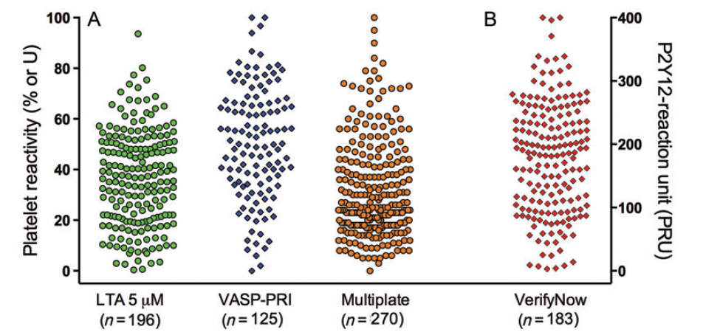
HTPR assays
Aradi D, et al. Expert position document. Eur Heart J Sep 2013

Slide 23
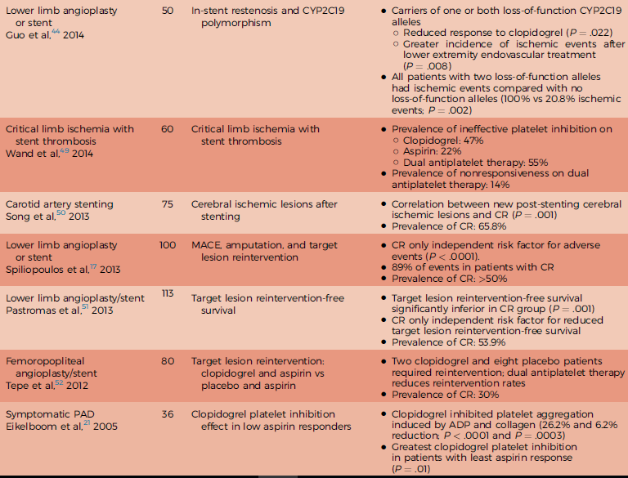
Guirgis M, JVS 2016 - http://dx.doi.org/10.1016/j.jvs.2017.07.065

Slide 24
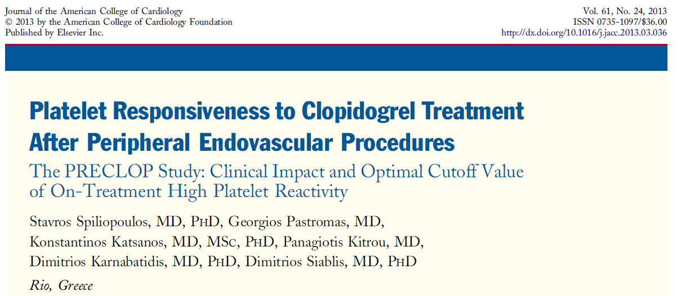
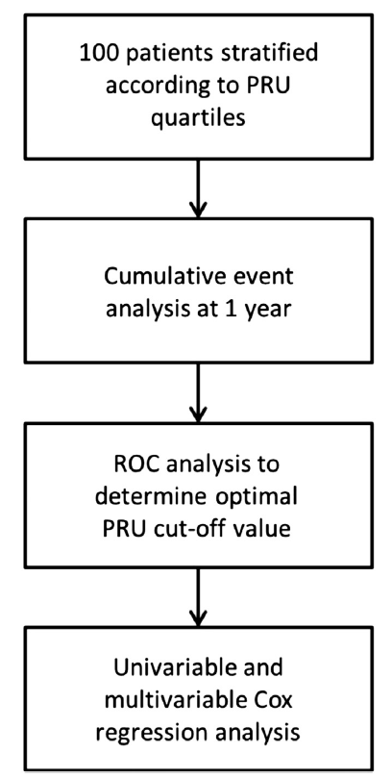
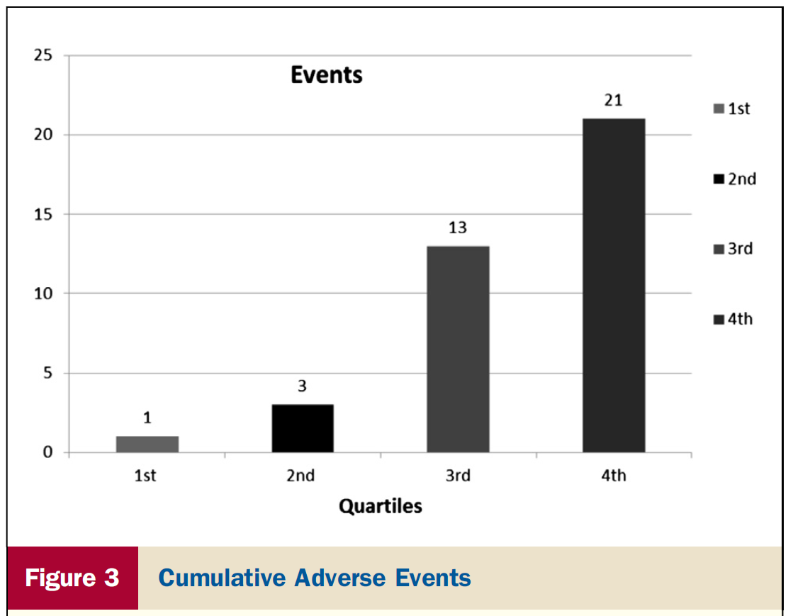
PRU>234

Slide 25
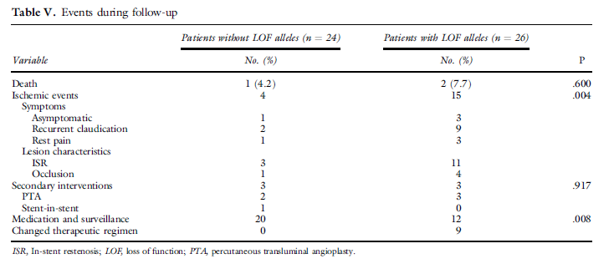
CYP2C19 loss of function alleles
50 endovascular procedures tested for CYP2C19 LOF
CYP2C19 genotypic classification (adjusted hazard ratio, 2.688; 95% confidence interval, 1.366-5.288; P =0.004) independent risk factor for ischemic events
Guo B, et al. JVS October 2014

Slide 26
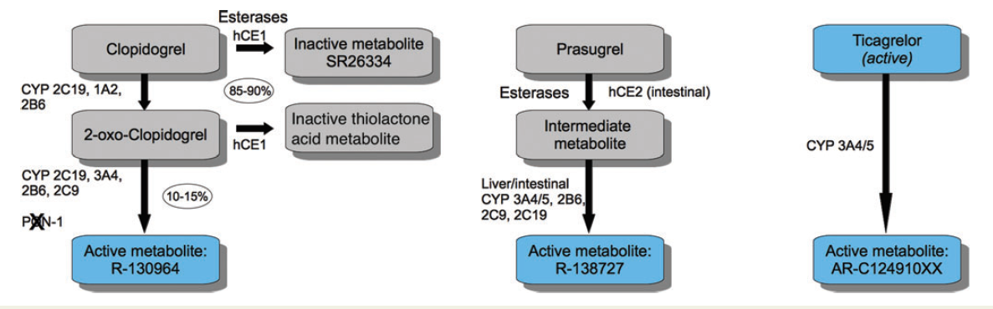
P2Y12 inhibitors
Clopidogrel is the only P2Y12 inhibitor with Food and Drug Association (FDA) approval for PAD
Aradi D, et al. Expert position document. Eur Heart J Sep 2013

Slide 27
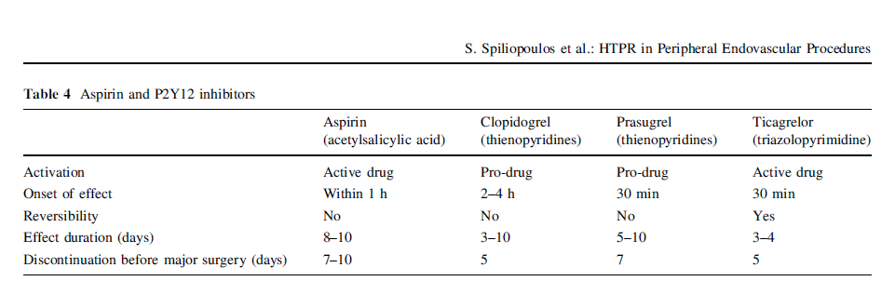
P2Y12 inhibitors
Correlated with increased bleeding events
including life-threatening haemorrhage
Spiliopoulos S, et al. High on-treatment platelet reactivity in peripheral endovascular procedures. Cardiovasc Intervent Radiol. 2014

Slide 28
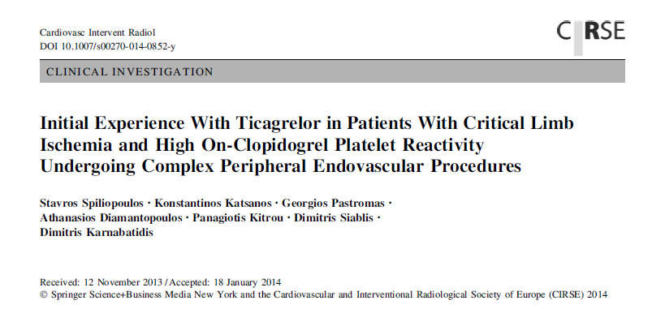
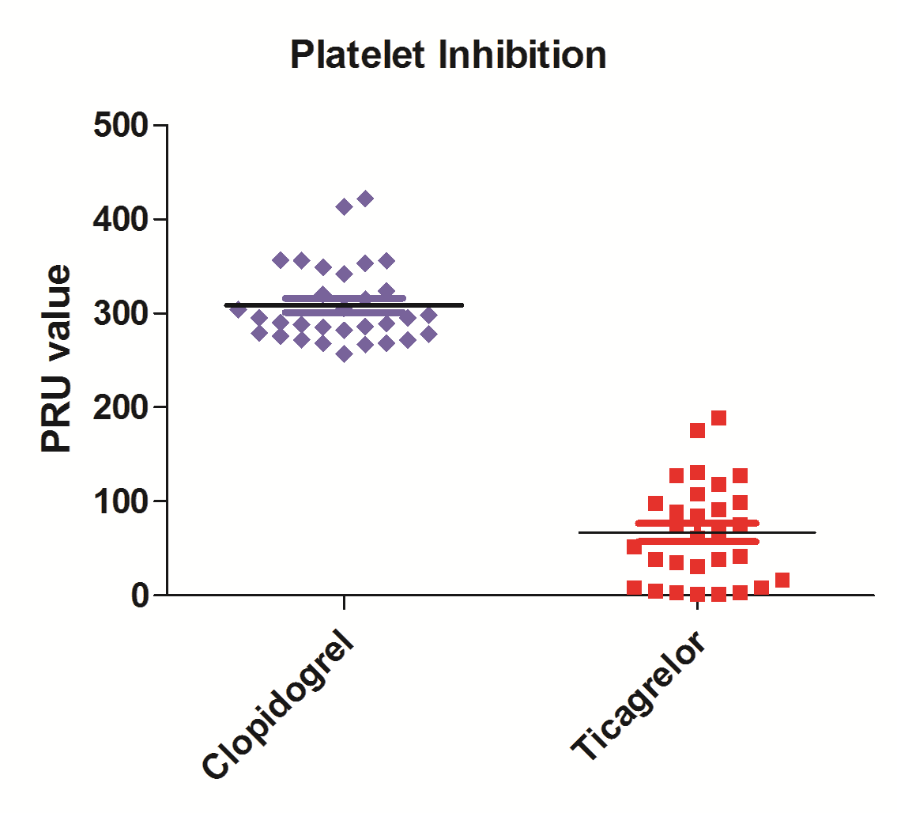
Mean PRU Clopidogrel 308.4 ± 41.8 (257-422)
vs. 65.0 ± 52.4 (2-189) with Ticagrelor;
p<0.0001

Slide 29
Antiplatelets in PAD
Current guidelines
Clopidogrel & Aspirin
Clopidogrel resistance
Ticagrelor data
NOAC & Aspirin

Slide 30
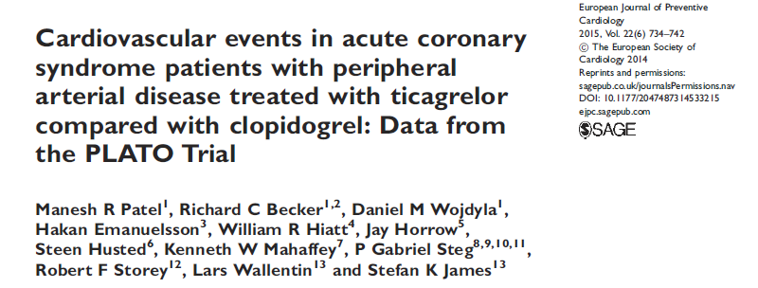
PLATO: Multicentre ACS study (n=18,624) ticagrelor vs clopidogrel (with ASA)
-16% relative risk reduction in favour of ticagrelor
PAD (n=1,144) post-hoc analysis on cardiovascular events

Slide 31
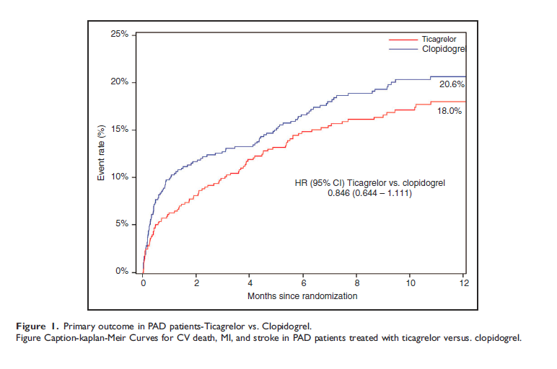
PLATO-PAD event rate (n=1,144)

Slide 32
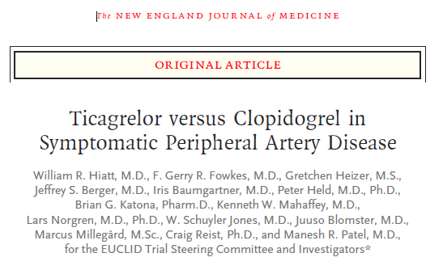
EUCLID
(Examining Use of tiCagreLor In paD)
Multicentre RCT (n=13,885) monotherapy
Ticagrelor 90mg bid vs Clopidogrel 75mg od

Slide 33
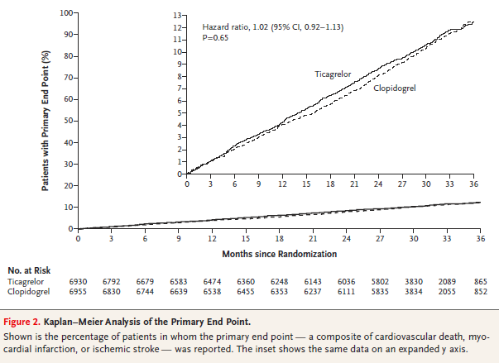

Slide 34
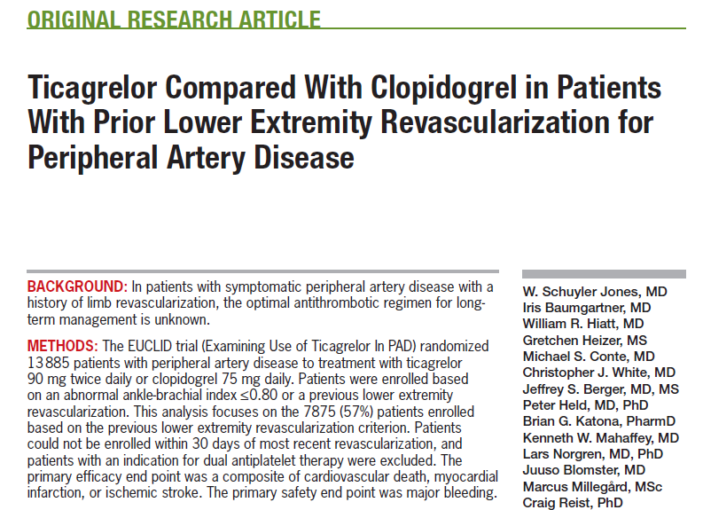
EUCLID post revascularization
Claudication 63% - Only 4.6% with CLI

Slide 35
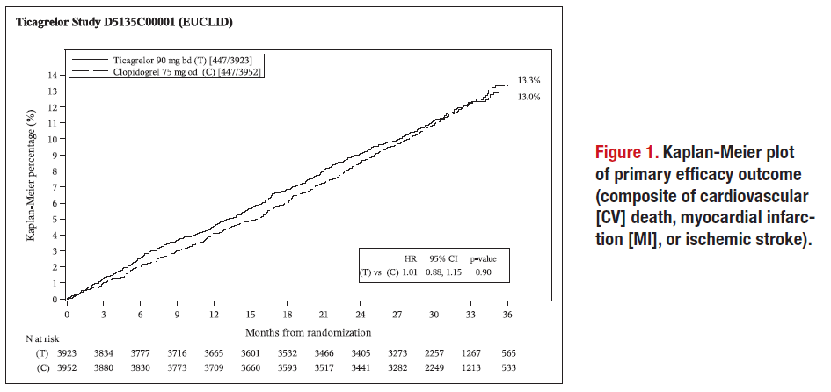
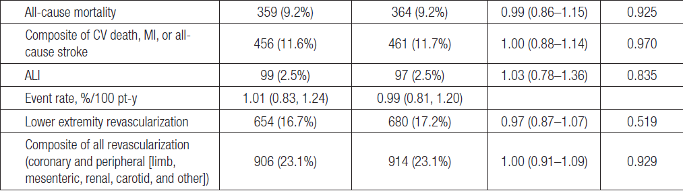

Slide 36
Antiplatelets in PAD
Current guidelines
Clopidogrel & Aspirin
Clopidogrel resistance
Ticagrelor data
NOAC & Aspirin

Slide 37
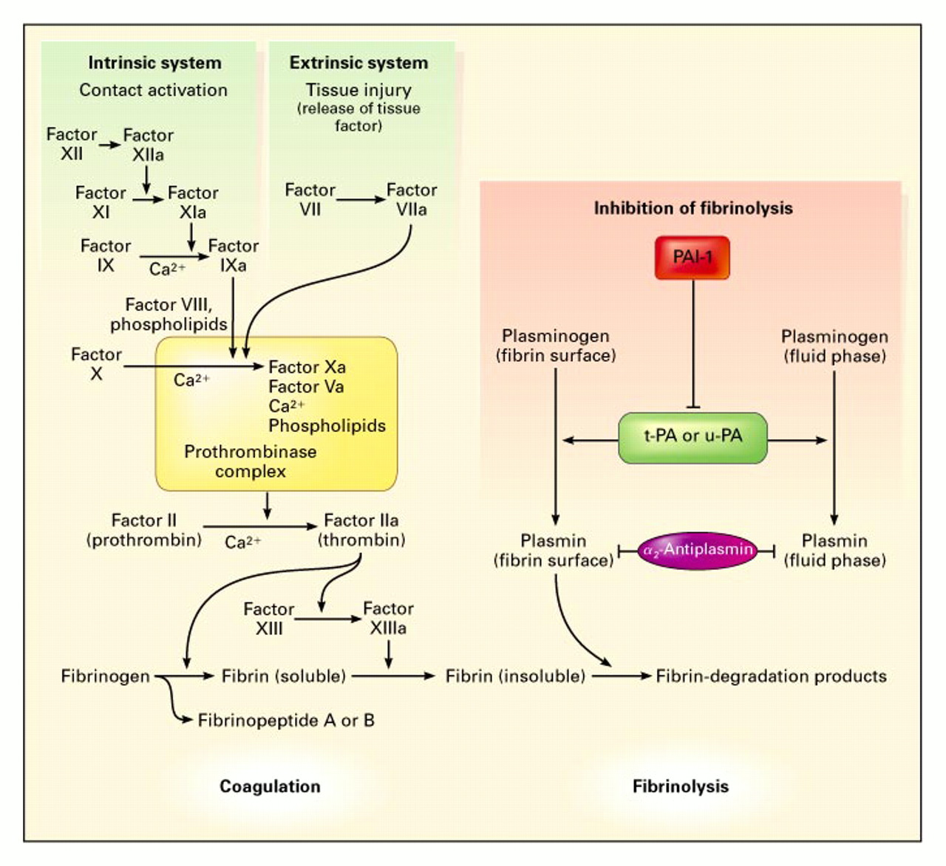
Anticoagulant drugs
Pathways of inhibition
Coagulation and Fibrinolytic Pathways
Kohler H and Grant P. N Engl J Med 2000;342:1792-1801
Notes:
The Coagulation and Fibrinolytic Pathways. The main coagulation reactions are divided into the intrinsic and extrinsic systems. Activation of factor XII on contact with a negatively charged surface initiates the intrinsic coagulation system. (The activated form of the factor is indicated by "a.") The extrinsic coagulation system induces the formation of a complex composed of factor VII and tissue factor, which is released after tissue injury. Some of these reactions depend on calcium ions. Thrombin is formed by an enzyme complex called prothrombinase, composed of factor X, factor V, negatively charged phospholipids, and calcium ions. Intrinsic and extrinsic activation of the coagulation cascade leads to the generation of thrombin, the activation of fibrinogen, the release of fibrinopeptides, the formation of soluble fibrin, and finally, the formation of factor XIII-mediated, cross-linked, insoluble fibrin. The main fibrinolytic reactions involve the inhibition of fibrinolysis by plasminogen-activator inhibitor type 1 (PAI-1) and {alpha}2-antiplasmin. Fibrinolysis is initiated by tissue plasminogen activator (t-PA), urinary-type plasminogen activator (u-PA), and plasmin. Plasmin bound to the surface of fibrin initiates the lysis of insoluble, cross-linked fibrin, with the subsequent generation of fibrin-degradation products. Plasmin bound to the surface of fibrin is better protected from inhibition by {alpha}2-antiplasmin than is plasmin generated in the fluid phase.

Slide 38
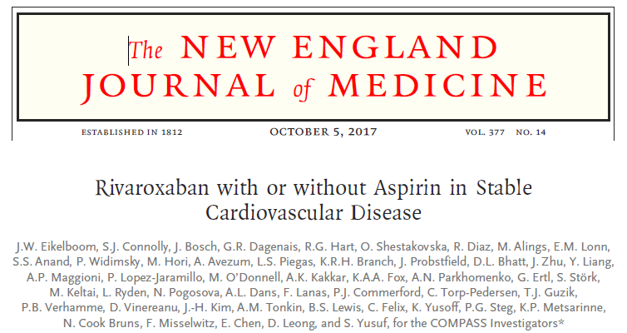
COMPASS trial
n=27,395 subjects randomized to rivaroxaban (2.5 mg twice daily) plus aspirin (100 mg once daily), rivaroxaban (5 mg twice daily), or aspirin (100 mg once daily).
7470 PAD patients—4129 with symptomatic PAD limbs, 1919 with carotid disease, and 1422 with CAD and low ankle-brachial index (<0.90).

Slide 39
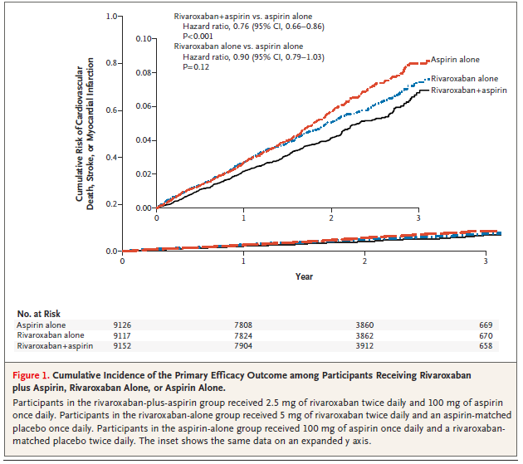
COMPASS results

Slide 40
COMPASS PAD cohort
Outcome | Rivaroxaban (2.5 mg twice daily) plus Aspirin (100 mg daily), n=2492 (%) | Aspirin (100 mg once daily) alone, n=2504 (%) | HR (95% CI) | P
Primary outcome: CV death/stroke/MI | 5.1 | 6.9 | 0.72 (0.57–0.90) | 0.005
Major adverse limb events | 1.2 | 2.2 | 0.54 (0.34–0.84) | 0.005
Major amputation | 0.2 | 0.7 | 0.30 (0.11–0.80) | 0.01
Composite of MACE/MALE/major amputation | 6.3 | 9.0 | 0.69 (0.56–0.85) | 0.0003
Major bleeding | 3.1 | 1.9 | 1.61 (1.12–2.31) | 0.009

Slide 41
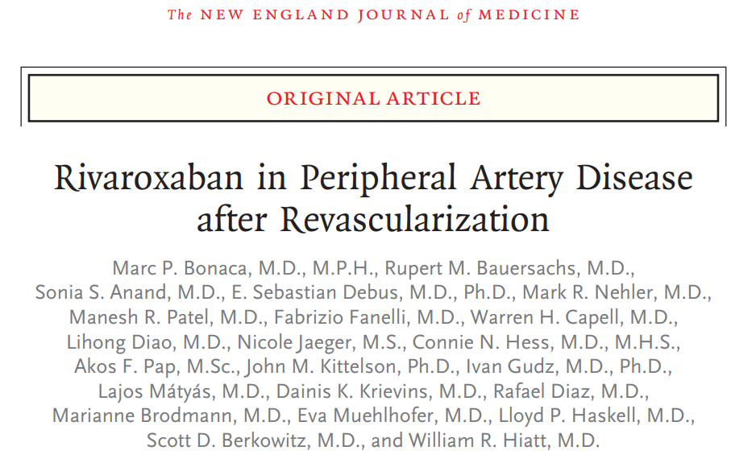
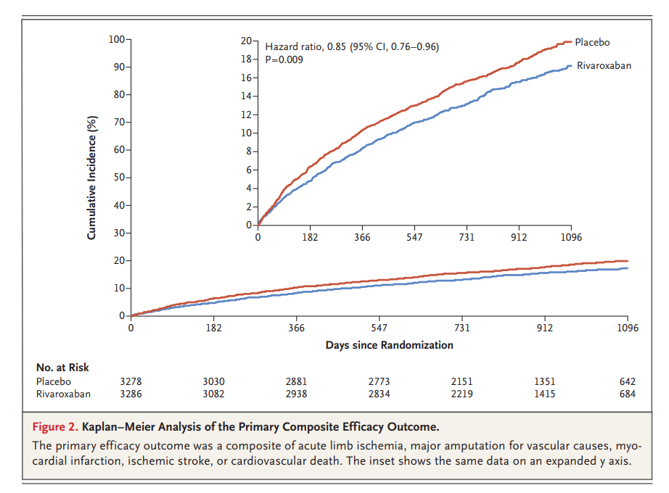
VOYAGER PAD

Slide 42
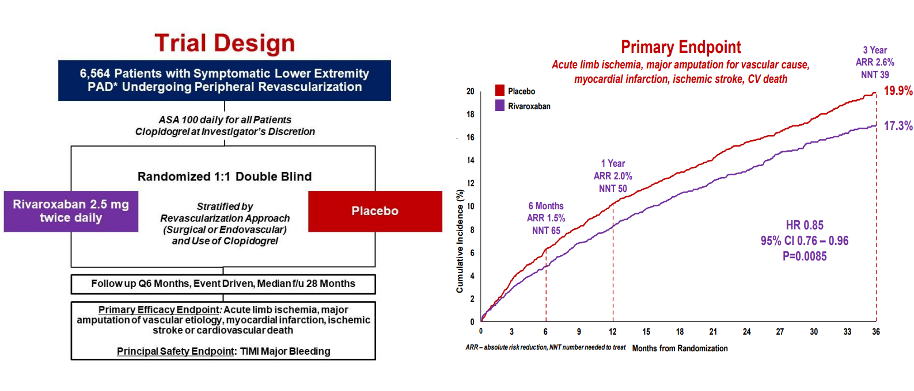
VOYAGER PAD
Claudication 77% / Critical limb ischemia 23%
Endovascular 65% / Surgical 35%

Slide 43
VOYAGER-PAD & Clopidogrel
In VOYAGER PAD, concomitant clopidogrel up to 6 months after the procedure was allowed and was taken by ≈50% of enrolled patients.

Slide 44
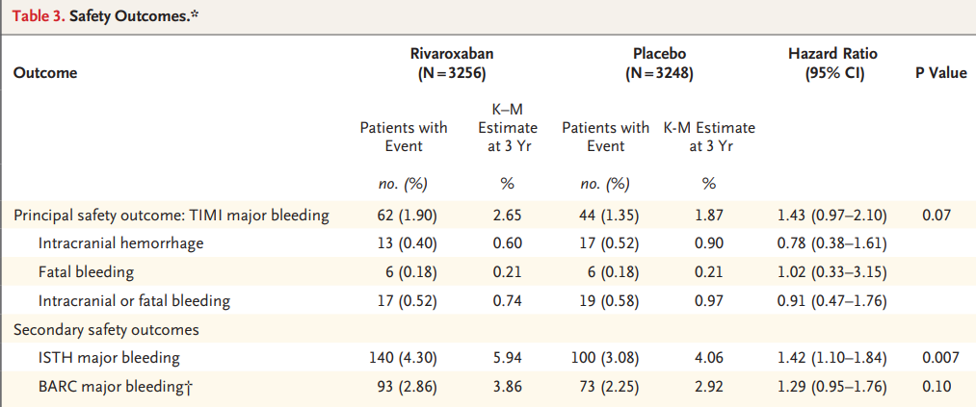
VOYAGER-PAD & Bleeding

Slide 45
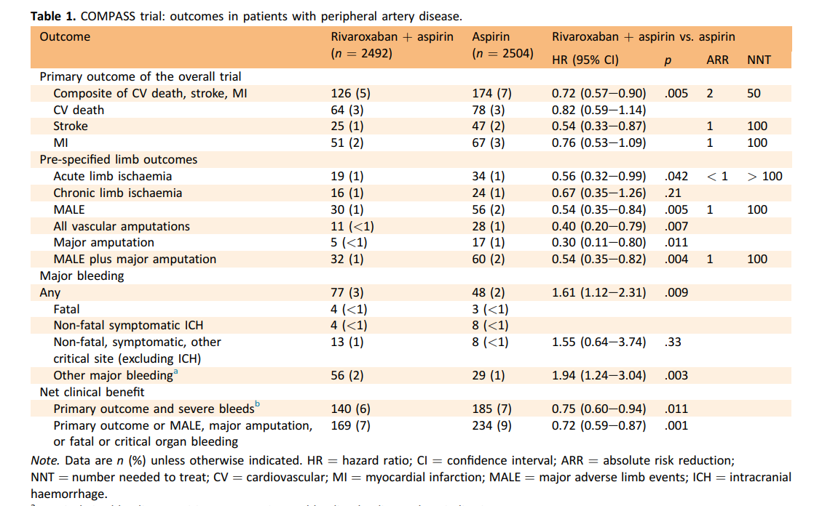
COMPASS
VOYAGER-PAD

Slide 46
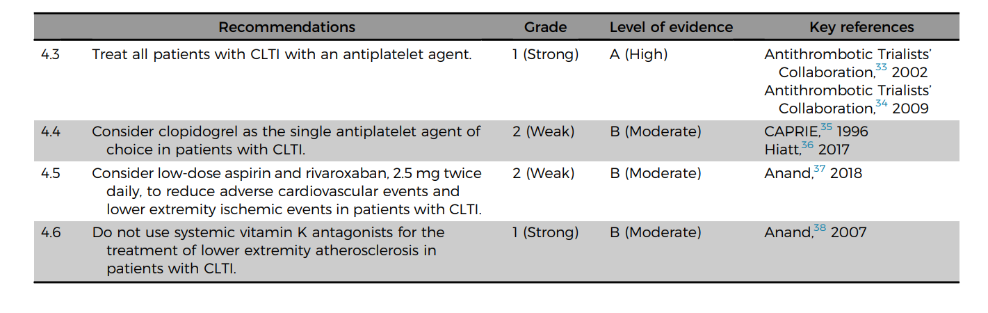
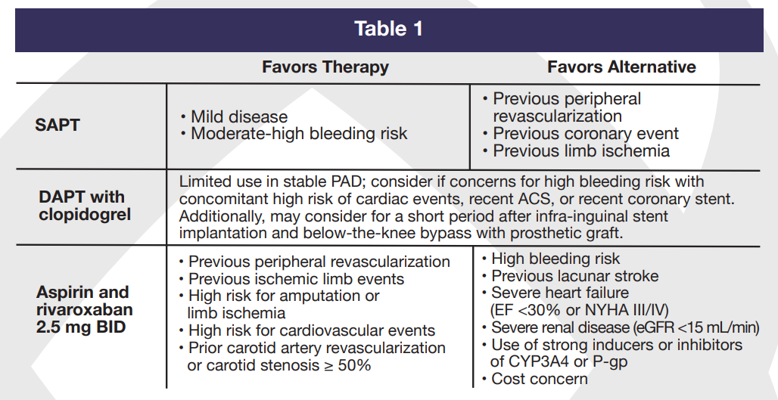
Global vascular guidelines for CLTI - 2019
RISK BENEFIT analysis
Anticoagulation forum
excellence.acforum.org

Slide 47
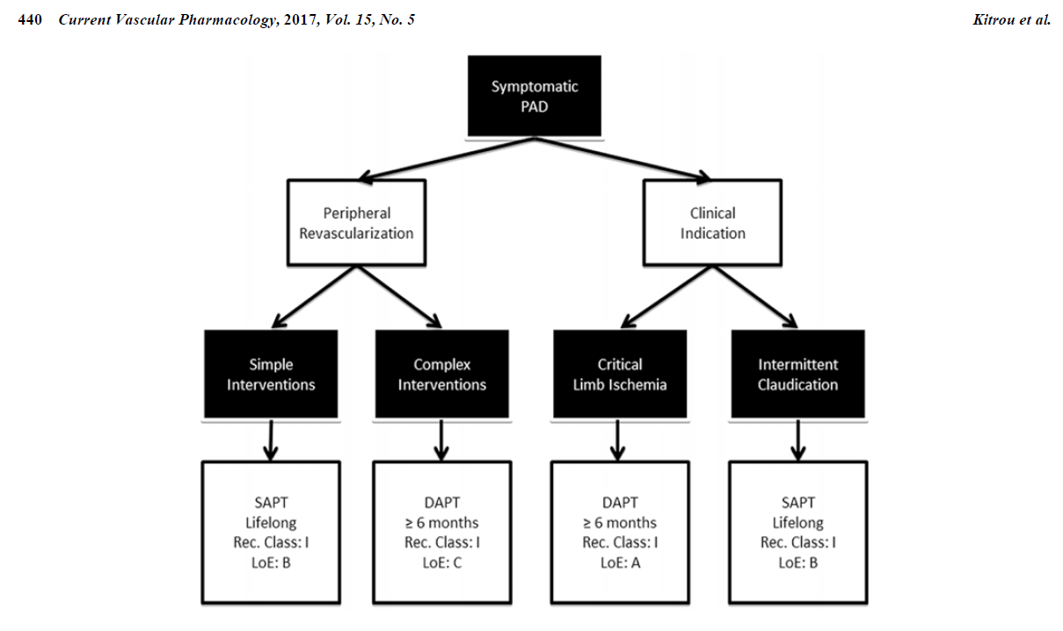
Clopidogrel is the agent of choice in PAD
Consider DAPT in Complex interventions and CLI
Low-dose NOAC and ASA/Clopidogrel?
NOAC and ASA: Systemic events vs Amputations?
We need CLI-specific studies

Slide 48
Thank You

Slide 50
Conclusions
Aspirin + Clopidogrel prevent major amputations in PAD patients following revascularization (32% relative risk reduction)

Slide 51
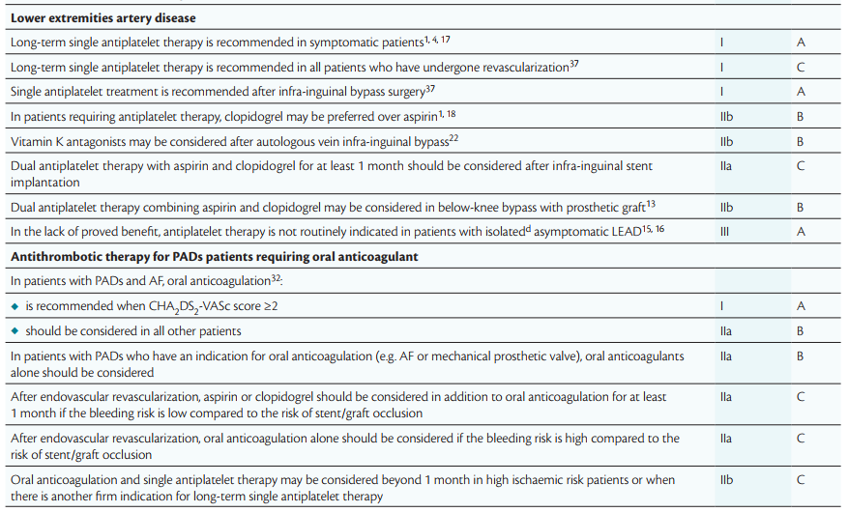
2017 ESC Guidelines on the Diagnosis and Treatment of Peripheral Arterial Diseases, in collaboration with the European Society for Vascular Surgery (ESVS)

Slide 52
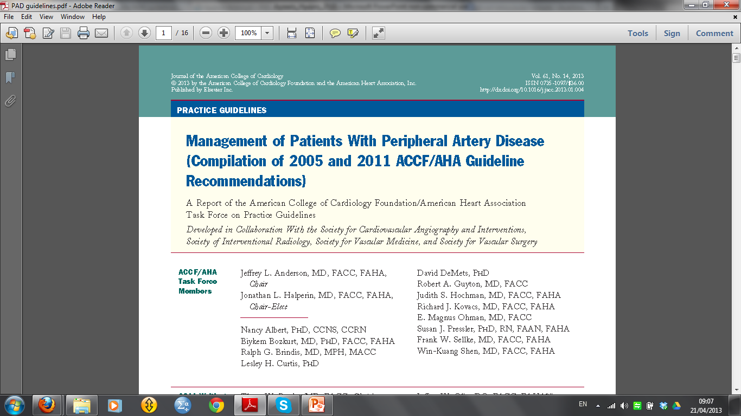
2011 Updated Recommendation CLASS I: Clopidogrel (75 mg per day) is recommended as a safe and effective alternative antiplatelet therapy to aspirin to reduce the risk of MI, ischemic stroke, or vascular death in individuals with symptomatic atherosclerotic lower extremity PAD, including those with intermittent claudication or CLI, prior lower extremity revascularization (endovascular or surgical), or prior amputation for lower extremity ischemia. (Level of Evidence: B)
2011 New Recommendation CLASS IIb:
The combination of aspirin and clopidogrel may be considered to reduce the risk of cardiovascular events in patients with symptomatic atherosclerotic lower extremity PAD, including those with intermittent claudication or CLI, prior lower extremity revascularization (endovascular or surgical), or prior amputation for lower extremity ischemia and who are not at increased risk of bleeding and who are high perceived cardiovascular risk. (Level of Evidence: B)

Slide 53
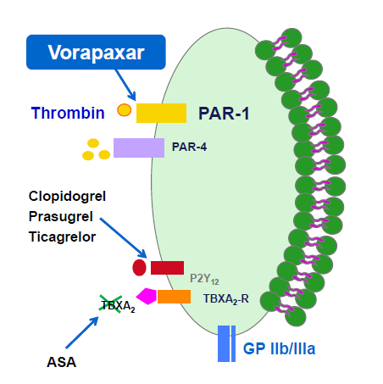
Vorapaxar
New antiplatelet agent: ZONTIVITY™(vorapaxar,)
Protease-activated receptor-1 (PAR-1) inhibitor
Diffent mechanism of action from P2Y₁₂ and ASA

Slide 54
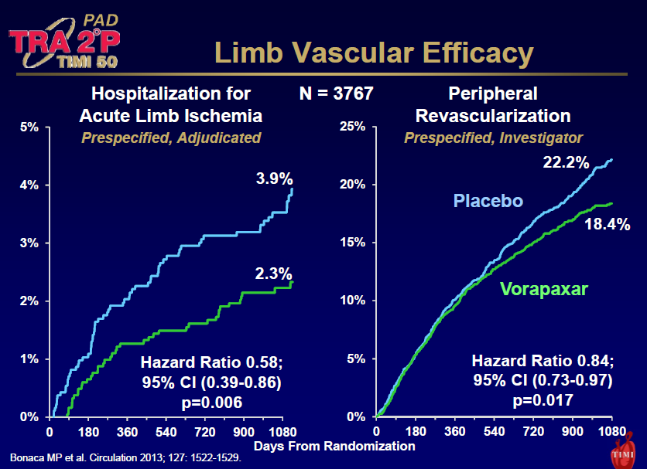

Slide 55
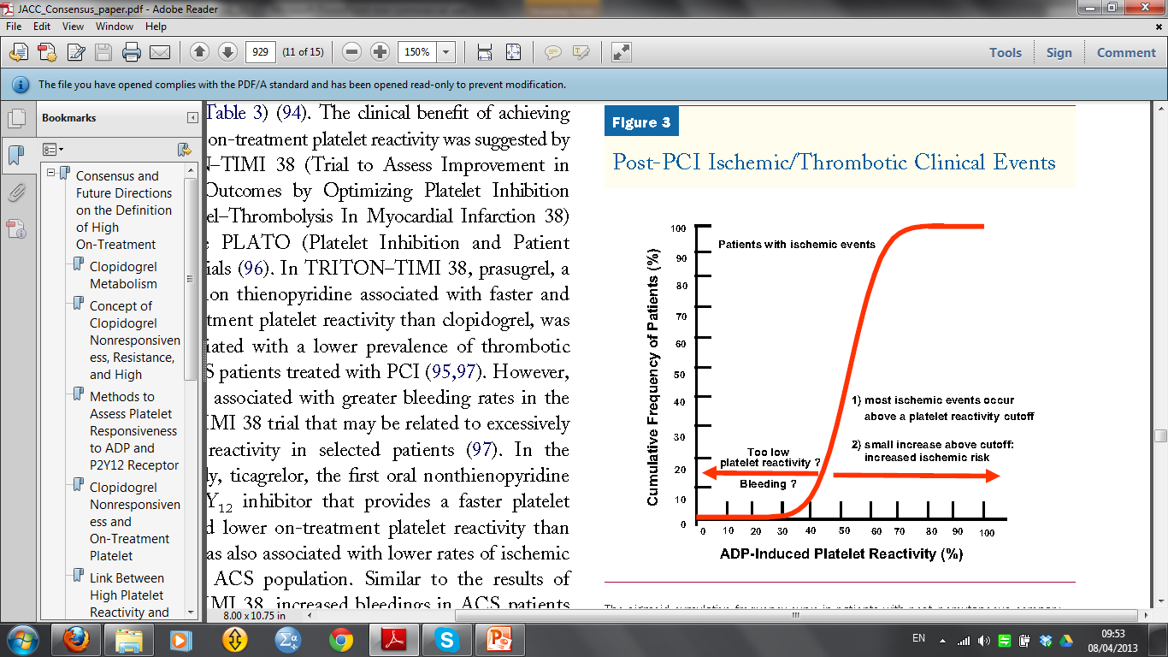
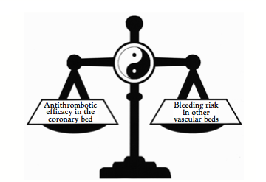
Conclusions III
Antithrombotic therapy: Risk (bleeding) – benefit (ischemia)
Therapeutic window
Gurbel PA, et al.J Am Coll Cardiol
Individualized therapy?
Platelet function testing for risk stratification?

Slide 56
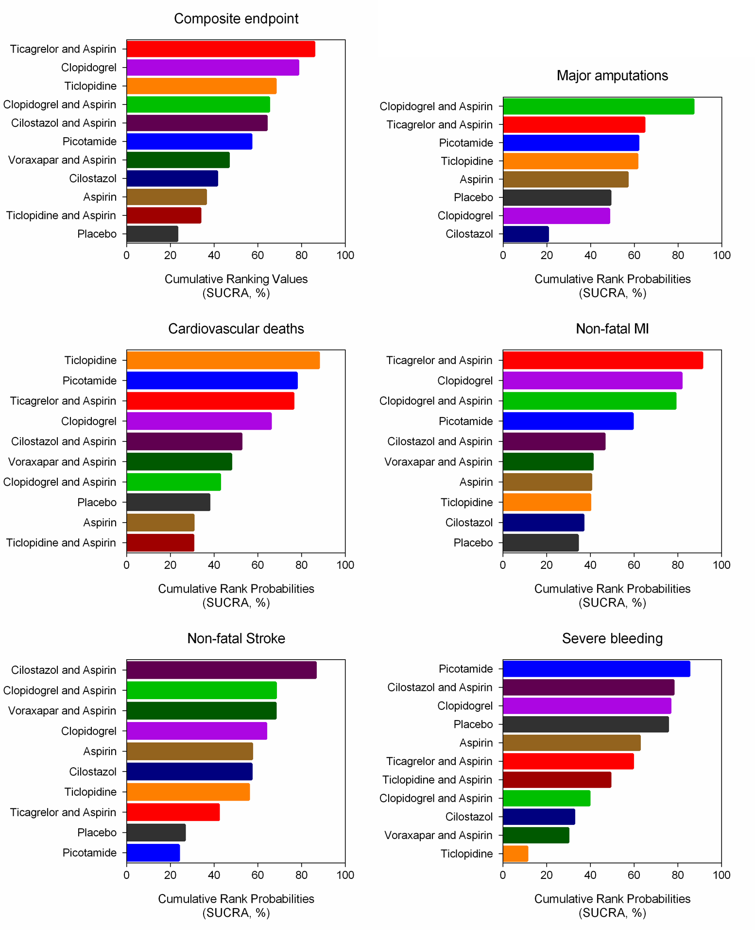
Katsanos K, et al. Comparative Efficacy and Safety of Different Antiplatelets in PAD. PLoS One. 2015 Aug
.

